Slide 1
Object Oriented Programming CSE- 310 Lecture - 4

Slide 2
Topics to be covered in this lecture
Multitasking
Thread
Lifecycle of a thread
Creating thread

Slide 3
Multitasking
Process-based Multitasking:
Own address in memory
Heavyweight
Cost of inter-communication high
Switching from one process is costly
Thread-based multitasking

Slide 4
Thread
Lightweight sub process
Independent
Shares a common memory
Multitasking
Cost of inter-communication low
Context switching is swift

Slide 5
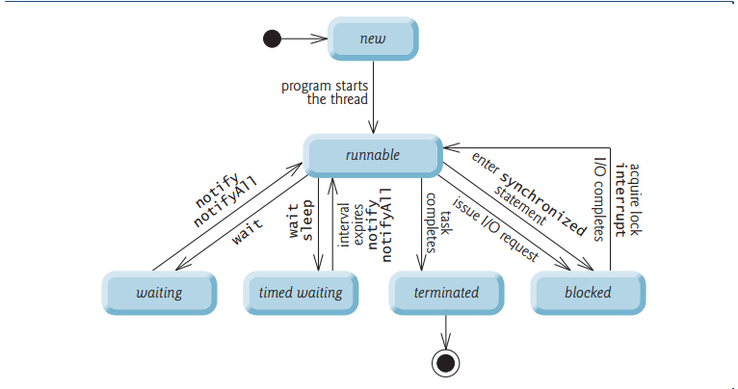
Lifecycle of a thread

Slide 6
Creating thread
By extending Thread class
By implementing Runnable interface
We can not start a thread twice
What if we call run() method directly instead start() method?

